Slide 3
QUESTION 1
Which actress portrays the character Eleven in Netflix’s Sci-fi Horror series ‘Stranger Things’?
Notes:
Millie Bobby Brown

Slide 4
QUESTION 2
How are Jon Snow and Daenerys related in the hit show ‘Game Of Thrones’?
Notes:
She is his aunt/he is her nephew

Slide 5
QUESTION 3
Which famous F.R.I.E.N.D.S actress stars in the Netflix show ‘Grace & Frankie’?
Notes:
Lisa Kudrow

Slide 6
QUESTION 4
What is Katy Perry’s real name?
Notes:
Katherine Elizabeth Hudson (Katherine Hudson)

Slide 7
QUESTION 5
Which UK Soap Opera features the pub named ‘The Dog in the Pond’?
Notes:
Hollyoaks

Slide 8
QUESTION 6
Which hit single went to number one in the U.S. in 2012 after an internet meme went viral with this song?
Notes:
Harlem Shake

Slide 9
QUESTION 7
This band was a one-hit wonder. Their hit was named ‘Breakfast at Tiffanys’. Please name the band?
Notes:
Deep Blue Something

Slide 10
QUESTION 8
Name the actress who plays the Queen of Genovia…
Notes:
Julie Andrews

Slide 11
QUESTION 9
A popular resturant is set to partially open as of next week. Name the restaurant?
Notes:
McDonalds

Slide 12
QUESTION 10
Tom Jones is a beloved famous artist from Treforest, Pontypridd born in the 1940’s. What year was he born?
Notes:
1940

Slide 14
QUESTION 1
Name the main spirit in the following cocktails:
Old Fashioned
Notes:
Whiskey

Slide 15
QUESTION 2
Name the main spirit in the following cocktails:
Harvey Wallbanger
Notes:
Vodka

Slide 16
QUESTION 3
Name the main spirit in the following cocktails:
Sidecar
Notes:
Cognac

Slide 17
QUESTION 4
Name the main spirit in the following cocktails:
Pornstar Martini
Notes:
Vodka

Slide 18
QUESTION 5
Name the main spirit in the following cocktails:
The Godfather
Notes:
Scotch Whiskey OR Amaretto (both equal parts)

Slide 19
QUESTION 6
Name the main spirit in the following cocktails:
Tom Collins
Notes:
Gin

Slide 20
QUESTION 7
Name the main spirit in the following cocktails:
Mai Tai
Notes:
Rum

Slide 21
QUESTION 8
What famous 6% cider is brewed in the Cornish seaside town of Newquay?
Notes:
Rattler

Slide 22
QUESTION 9
Clwb Tropicana and Stay Puft are two types of beer created by which brewery?
Notes:
Tiny Rebel

Slide 23
QUESTION 10
Also known as a ‘Blind Pig’ or a ‘Blind Tiger’ what is the slang name for an establishment selling alcoholic drinks in the Prohibition era?
Notes:
Speakeasy

Slide 25
QUESTION 1
What is the first name of Leonardo DiCaprio’s character in the 2013 film ‘The Great Gatsby’?
Notes:
Jay (Jay Gatsby)

Slide 26
QUESTION 2
‘The Circle of Life’ was written and released by Elton John. What is the name the other song that he created for ‘The Lion King’?
Notes:
Can you feel the love tonight?

Slide 27
QUESTION 3
Liam Neeson plays the character ‘Qui Gon Jinn’ in the Star Wars saga. Which Star Wars film does he first feature in?
Notes:
Episode I - The Phantom Menace

Slide 28
QUESTION 4
‘Everything is Awesome’ is a song from the soundtrack of which 2014 movie?
Notes:
The LEGO movie

Slide 29
QUESTION 5
‘The Further’ is a mythical realm in which demonic spirits live in which series of popular thrillers directed by James Wan?
Notes:
Insidious

Slide 30
QUESTION 6
Bridget Jones has three best friends. The first named Jude and the second, Shazza. What is the name of their gay best friend?
Notes:
Tom

Slide 31
QUESTION 7
Judi Dench played M in the James Bond series of films. How many films did she feature in?
Notes:
7

Slide 32
QUESTION 8
‘Ocean’s 8’ features an all star female line up. What is the name of Danny Ocean’s sister played by Sandra Bullock?
Notes:
Debbie Ocean

Slide 33
QUESTION 9
What are the names of the two male gargoyles who feature in Disney’s adaptation of Victor Hugo’s novel ‘The Hunchback of Notre Dame’?
Notes:
Victor & Hugo

Slide 34
QUESTION 10
Carrie Fisher played the Princess Leia in the Star Wars saga and starred alongside her daughter in the final trilogy. What is her daughters name?
Notes:
Billie Lourd

Slide 36
QUESTION 1
In it’s simplest form, what does the code CMYK stand for?
Notes:
Cyan | Magenta | Yellow | Key (Blue, Pink, Yellow, Black)

Slide 37
QUESTION 2
Name this font:
HELLO I’m a friendly font.
Notes:
Comic Sans

Slide 38
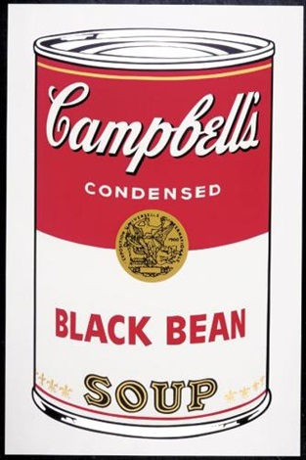
QUESTION 3
Which famous artist designed
the iconic ‘Campbells Soup’ piece?
Notes:
Andy Warhol

Slide 39
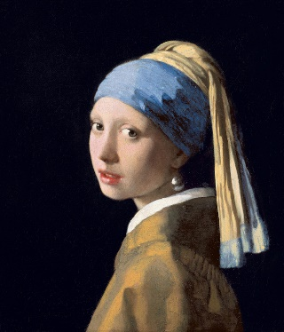
What is the name this famous painting?
QUESTION 4
Notes:
The girl with the pearl earring

Slide 40
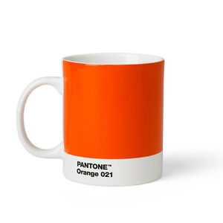
QUESTION 5
What is the name of the industry colour matching coding that can be purchased on items such as mugs and water bottles?
Notes:
Pantone

Slide 41
QUESTION 6
What is the Pantone Colour of the Year 2020?
Notes:
Classic Blue

Slide 43
CHALLENGE
It’s 1945 and you’re off out to celebrate. You need to bring:
1. A tinned item, 2. Headscarf (of any material), 3. Bubbly & 4. an Egg
ONE POINT PER ITEM EACH

Slide 44
QUESTION 1
Who played Winston Churchill in the film ‘Darkest Hour’?
Notes:
Gary Oldman

Slide 45
QUESTION 2
What is the date that Germany signed the official surrender and Europe officially declared victory over Germany in WW2?
Notes:
08.05.1945 (VE DAY)

Slide 46
QUESTION 3
Which Disney film was set during WW2 starring Angela Lansbury?
Notes:
Bedknobs & Broomsticks

Slide 47
QUESTION 4
During WW2 many items that we take for granted were rationed. To the nearest gram, how much butter was given per adult per week?
10GRAMS
50GRAMS
100GRAMS
Notes:
50g Butter

Slide 48
QUESTION 5
During WW2 many items that we take for granted were rationed. To the nearest gram, how much sugar was given per adult per week?
225GRAMS
300GRAMS
500GRAMS
Notes:
225g Sugar

Slide 49
QUESTION 6
During WW2 many items that we take for granted were rationed. To the nearest gram, how much cheese was given per adult per week?
10GRAMS
25.75GRAMS
50GRAMS
Notes:
50g Cheese

Slide 50
QUESTION 7
Which famous WW2 singer famously sang the song ‘There’ll Be Blue Birds Over The White Cliffs Of Dover’?
Notes:
Vera Lynn

Slide 51
QUESTION 8
Which famous harbour on a U.S. naval base was bombed in WW2?
Notes:
Pearl Harbour

Slide 52
QUESTION 9
The London Blackout in WW2 was also known as what event?
Notes:
The Blitz

Slide 53
QUESTION 10
In which year did rationing end after WW2?
Notes:
4th July 1954

