Slide 1
LET’S GET QUIZZICAL

Slide 2
ROUND 3:
THE ROUNDS
ROUND 2:
ROUND 1:
ROUND 6:
ROUND 4 :
ROUND 5:

Slide 3
ROUND 1:

Slide 4
The questions:
Q1: In "The Little Mermaid" What are the names of Ursula's eels?
Q2: How long was the Genie stuck in the lamp before Aladdin released him?
Q3: Which one of these princesses is NOT part of Disney’s official princess lineup? Elsa or Merida
Q4: What's the name of the gigantic Australian shark in Finding Nemo?
Q5: What do Aladdin and his monkey Abu steal from the marketplace when you’re first introduced to them in the movie?
Q6: What is the name of Mulan’s pet dragon?
Q7: Which classic Disney princesses lived in Bavaria?
Q8: In 1993, three hopefuls joined the Mickey Mouse Club. Today, they are three popular musical artists. Who were they?
Q9: What Disney movie received the first ever Oscar nomination in the company’s entire history?
Q10: How many daughters does King Triton have in The Little Mermaid? (+1 Point if you can NAME them)

Slide 5
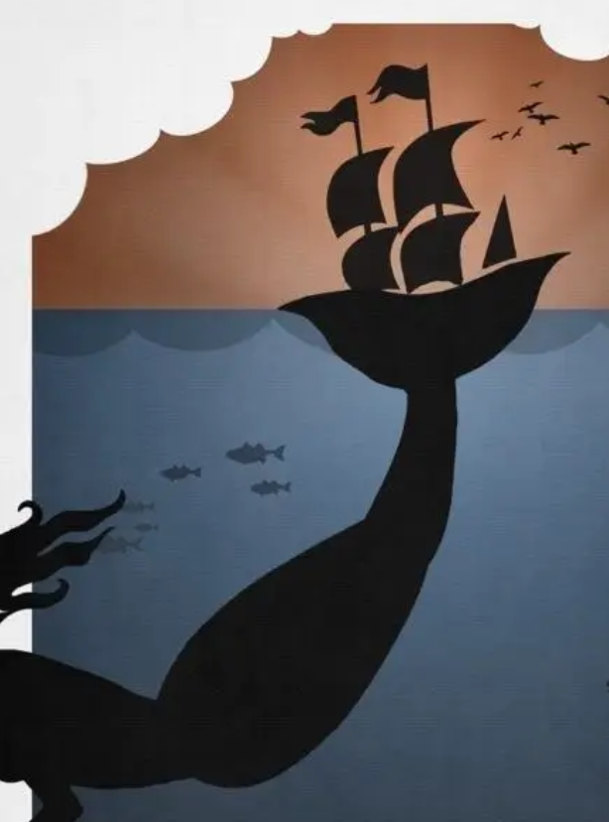
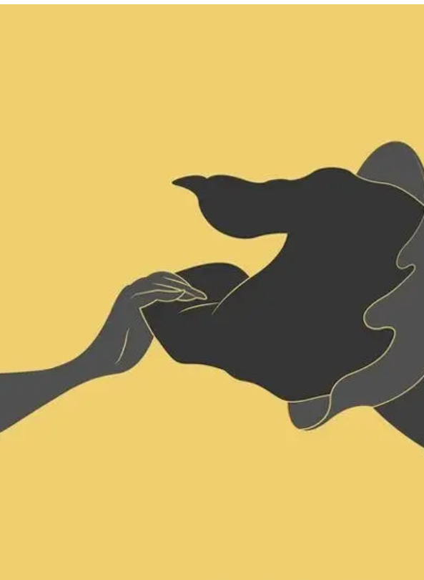
Minimalistic magic:
Guess the film…

Slide 6
ROUND 2:
brands

Slide 7
Guess the brands:
Team 1:
Team 2:
LOGOS 1 -13
LOGOS 14 -25

Slide 8
1
2
3
4
5
Guess the brands
6
7
8
9
10
11
12
13
14
15
YOU HAVE 5 MINUTES TO GUESS AS MANY AS YOU CAN…
16
17
18
19
20
21
22
23
24
25

Slide 9
Who’s is that slogan?
“The Best A Man Can Get”
“The Happiest Place on Earth!”
“Eat Fresh!”
“Every Little Helps!”
“The Ultimate Driving Machine!”
“It’s The
REAL Thing!”
“Don’t Leave Home Without It!”
“The Worlds Local Bank”

Slide 10
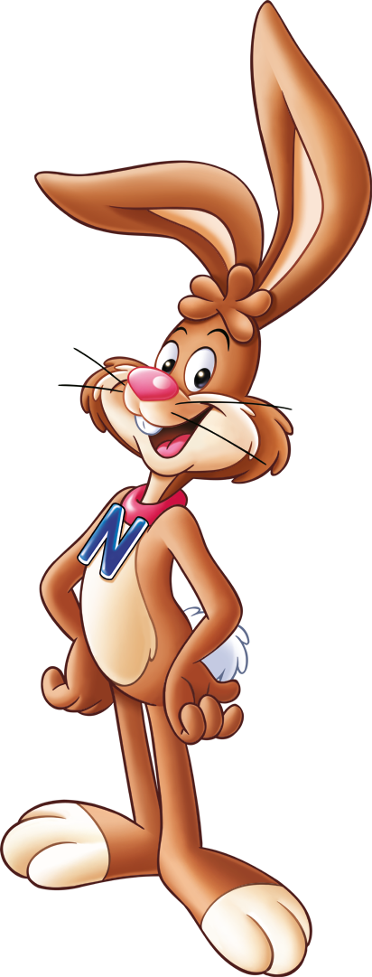
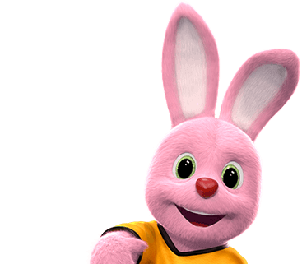
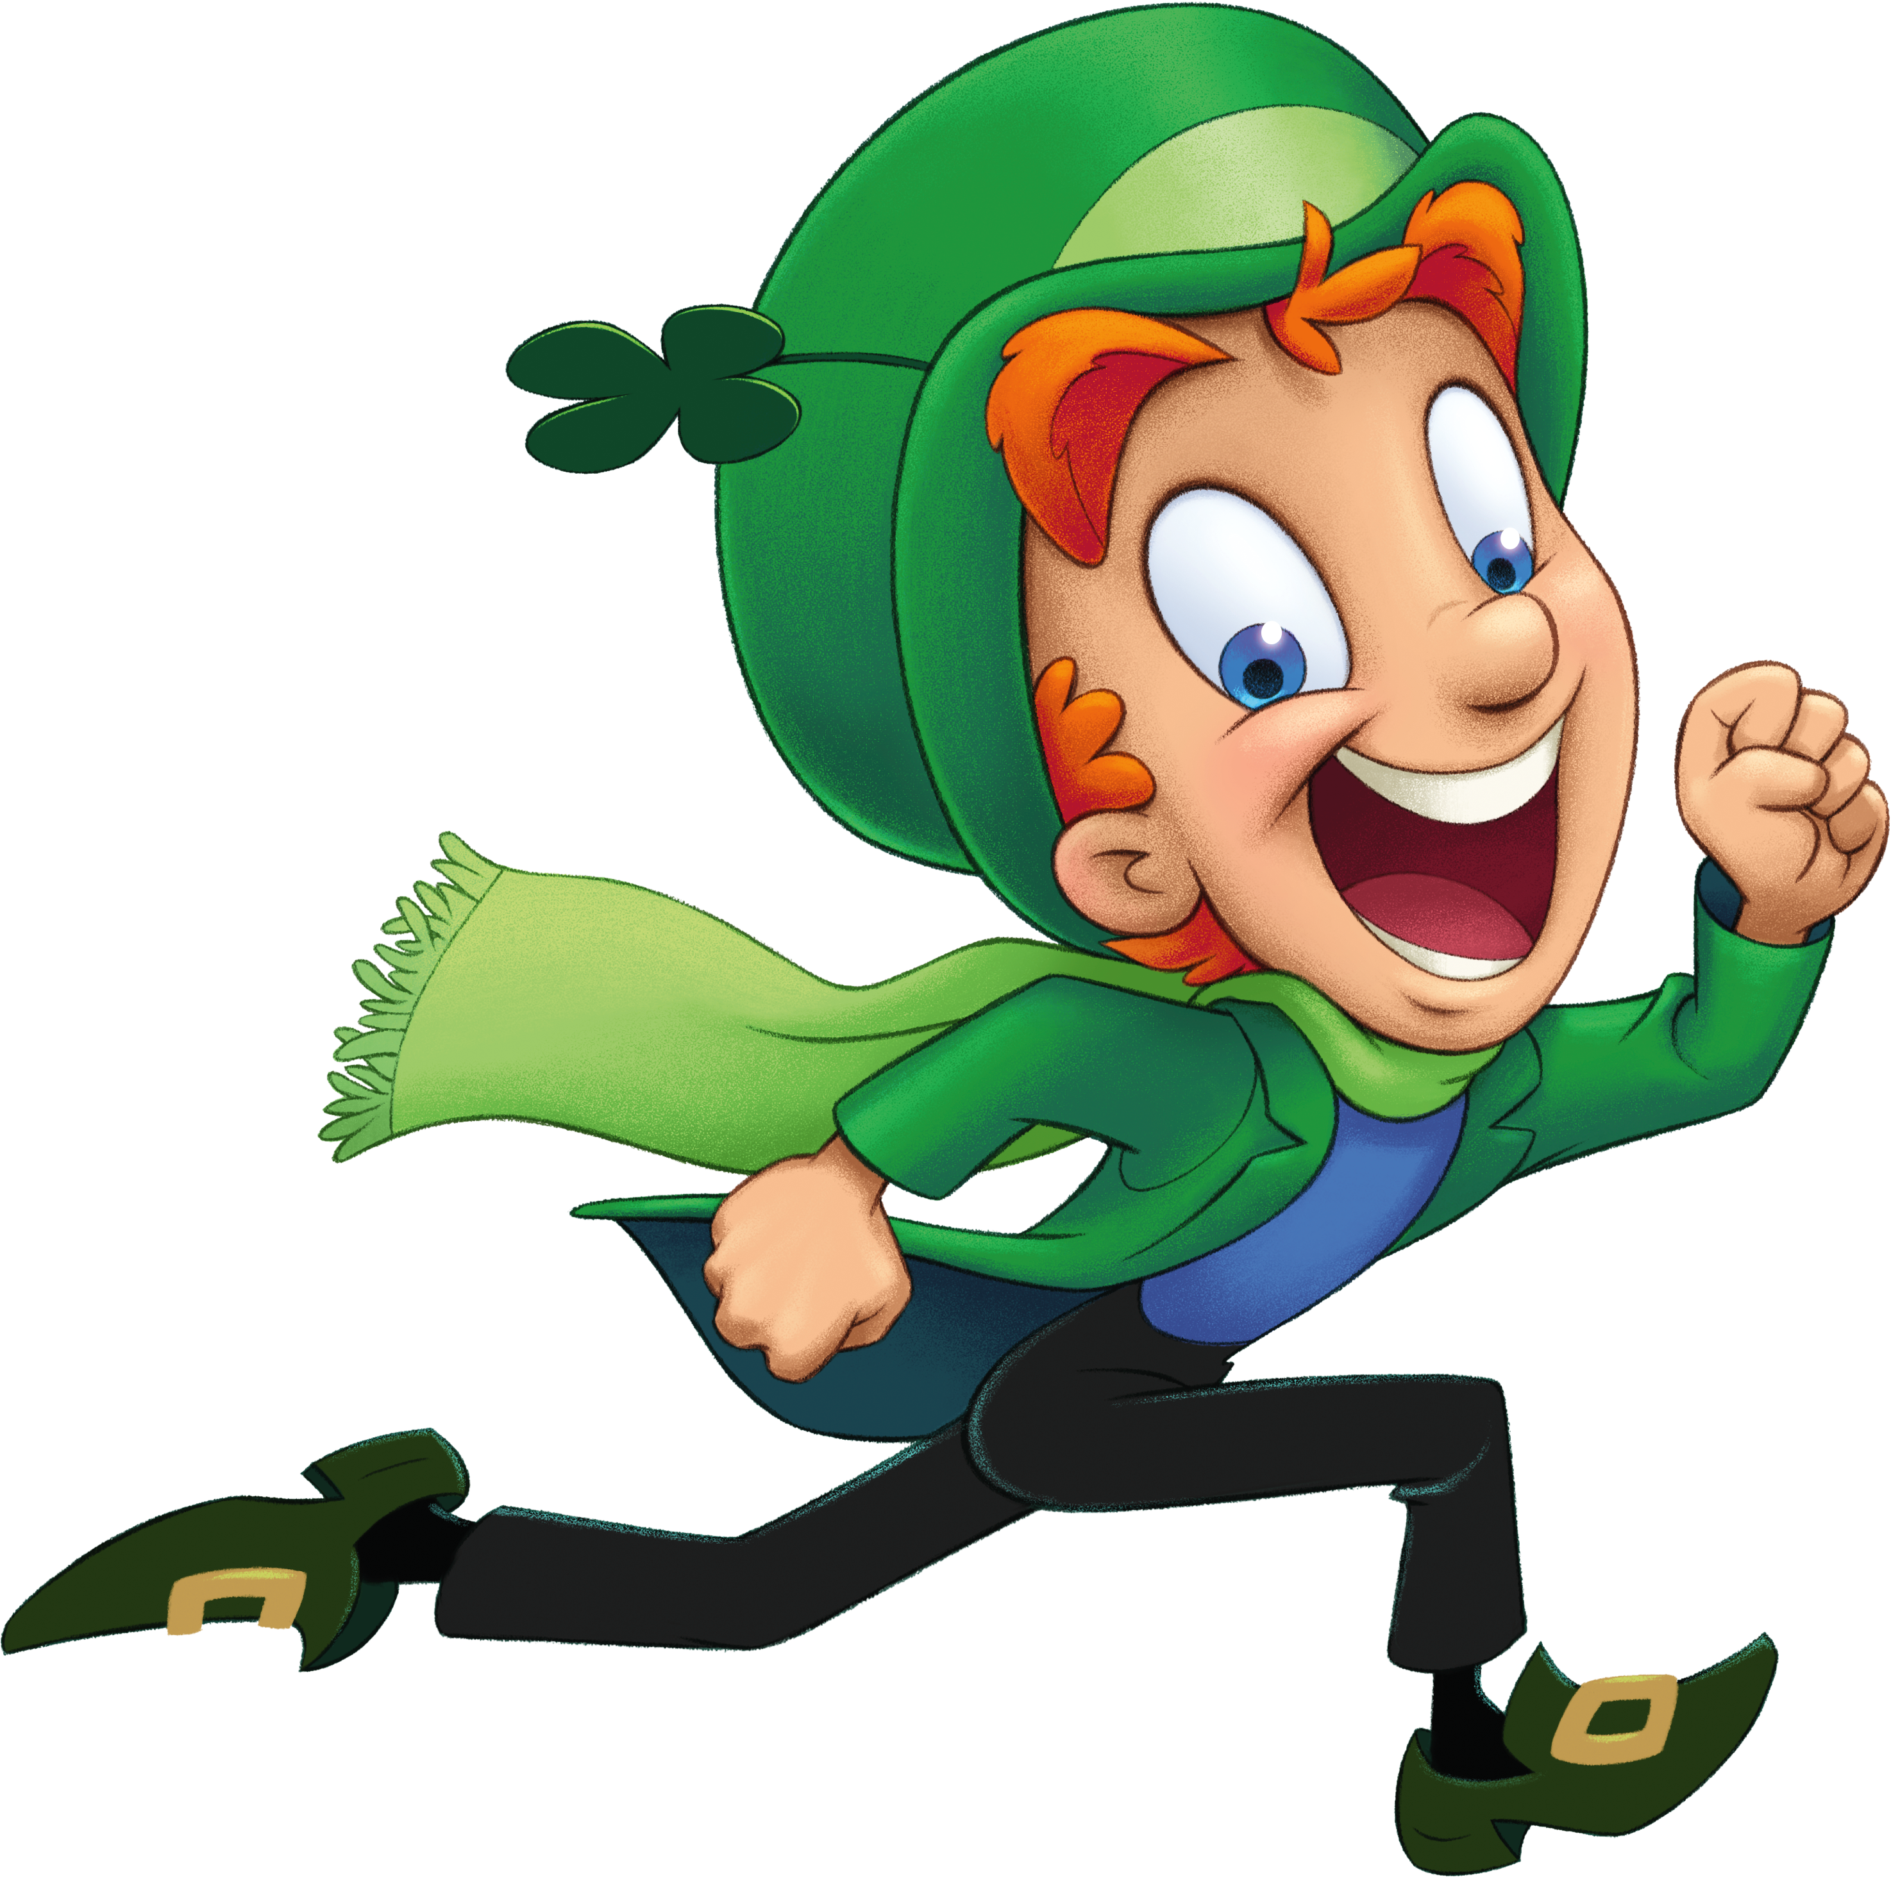
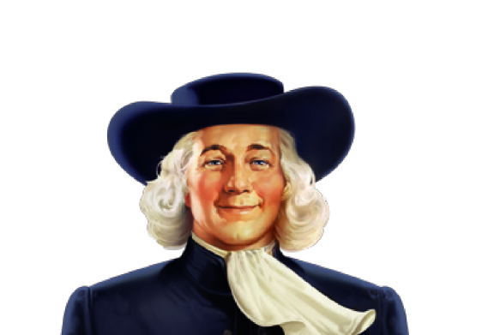
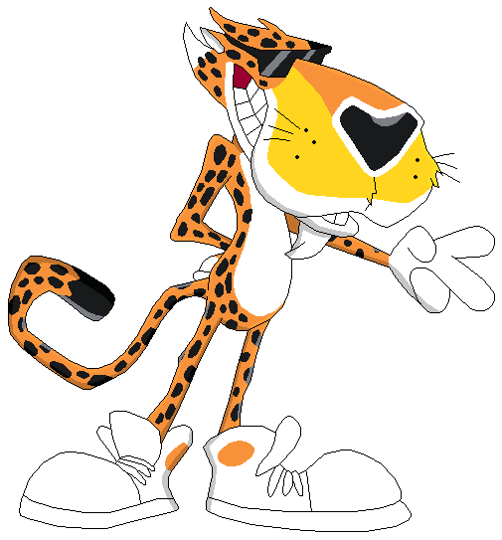
1 Point – Name
1 Point – Brand
Who are they?
1
2
3
4
5
6
7
8

Slide 11
ROUND 3:
Film & tv

Slide 12
The questions:
Q1: How many seasons of the hit US comedy ‘Friends’ were made?
Q2: “I’m the King of the World!” is quote from what film?
Q3: SOLVE THIS FAMOUS DIRECTOR ANAGRAM| MUTTON RIB
Q4: Who directed the first two films in the ‘Home Alone’ series?
Q5: In which English seaside town was ‘Fawlty Towers’ set?
Q6: David Bowie & Jennifer Connelly teamed up in which visionary classic from Jim Henson?
Q7: "Greed is Good" is the motto from which 1980s Michael Douglas film?
Q8: SOLVE THIS ACTRESS ANAGRAM| PERM RESTYLE
Q9: Starring Eddie Murphy, which film is about a very pampered African prince who travels to Queens, New York City?
Q10: Who played the female lead Linda in the sitcom Gimme Gimme Gimme?
A

Slide 13
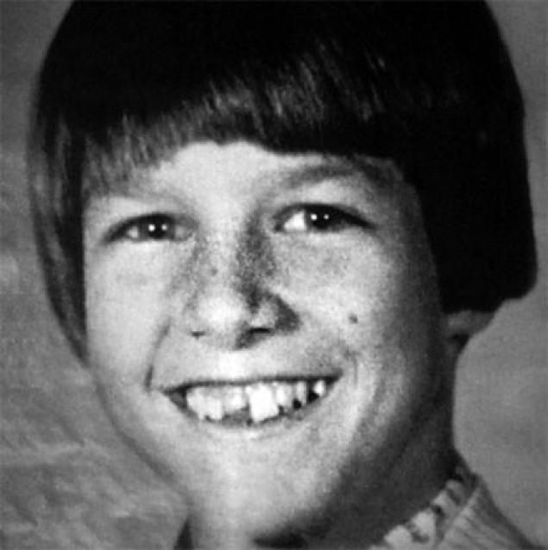
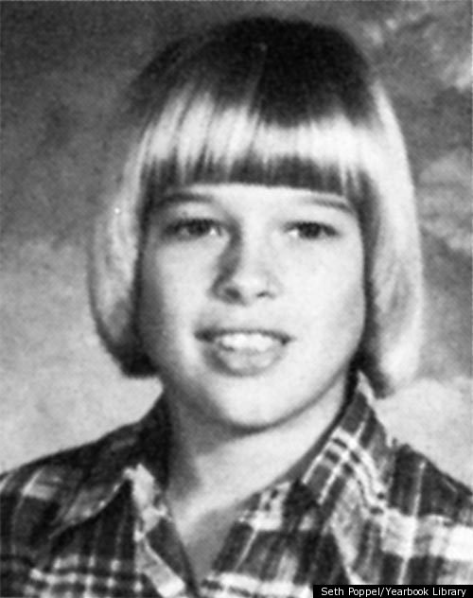
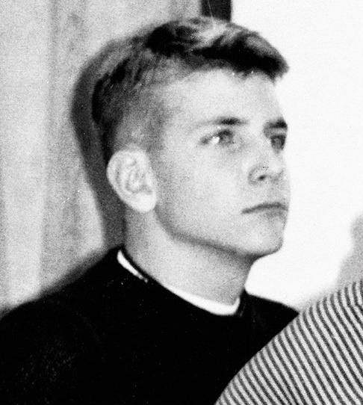
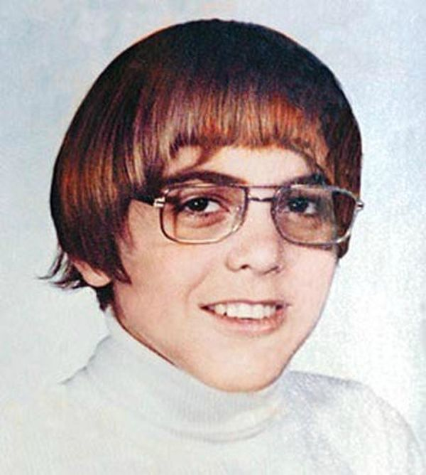
Guess the celeb…
1
4
3
2

Slide 14
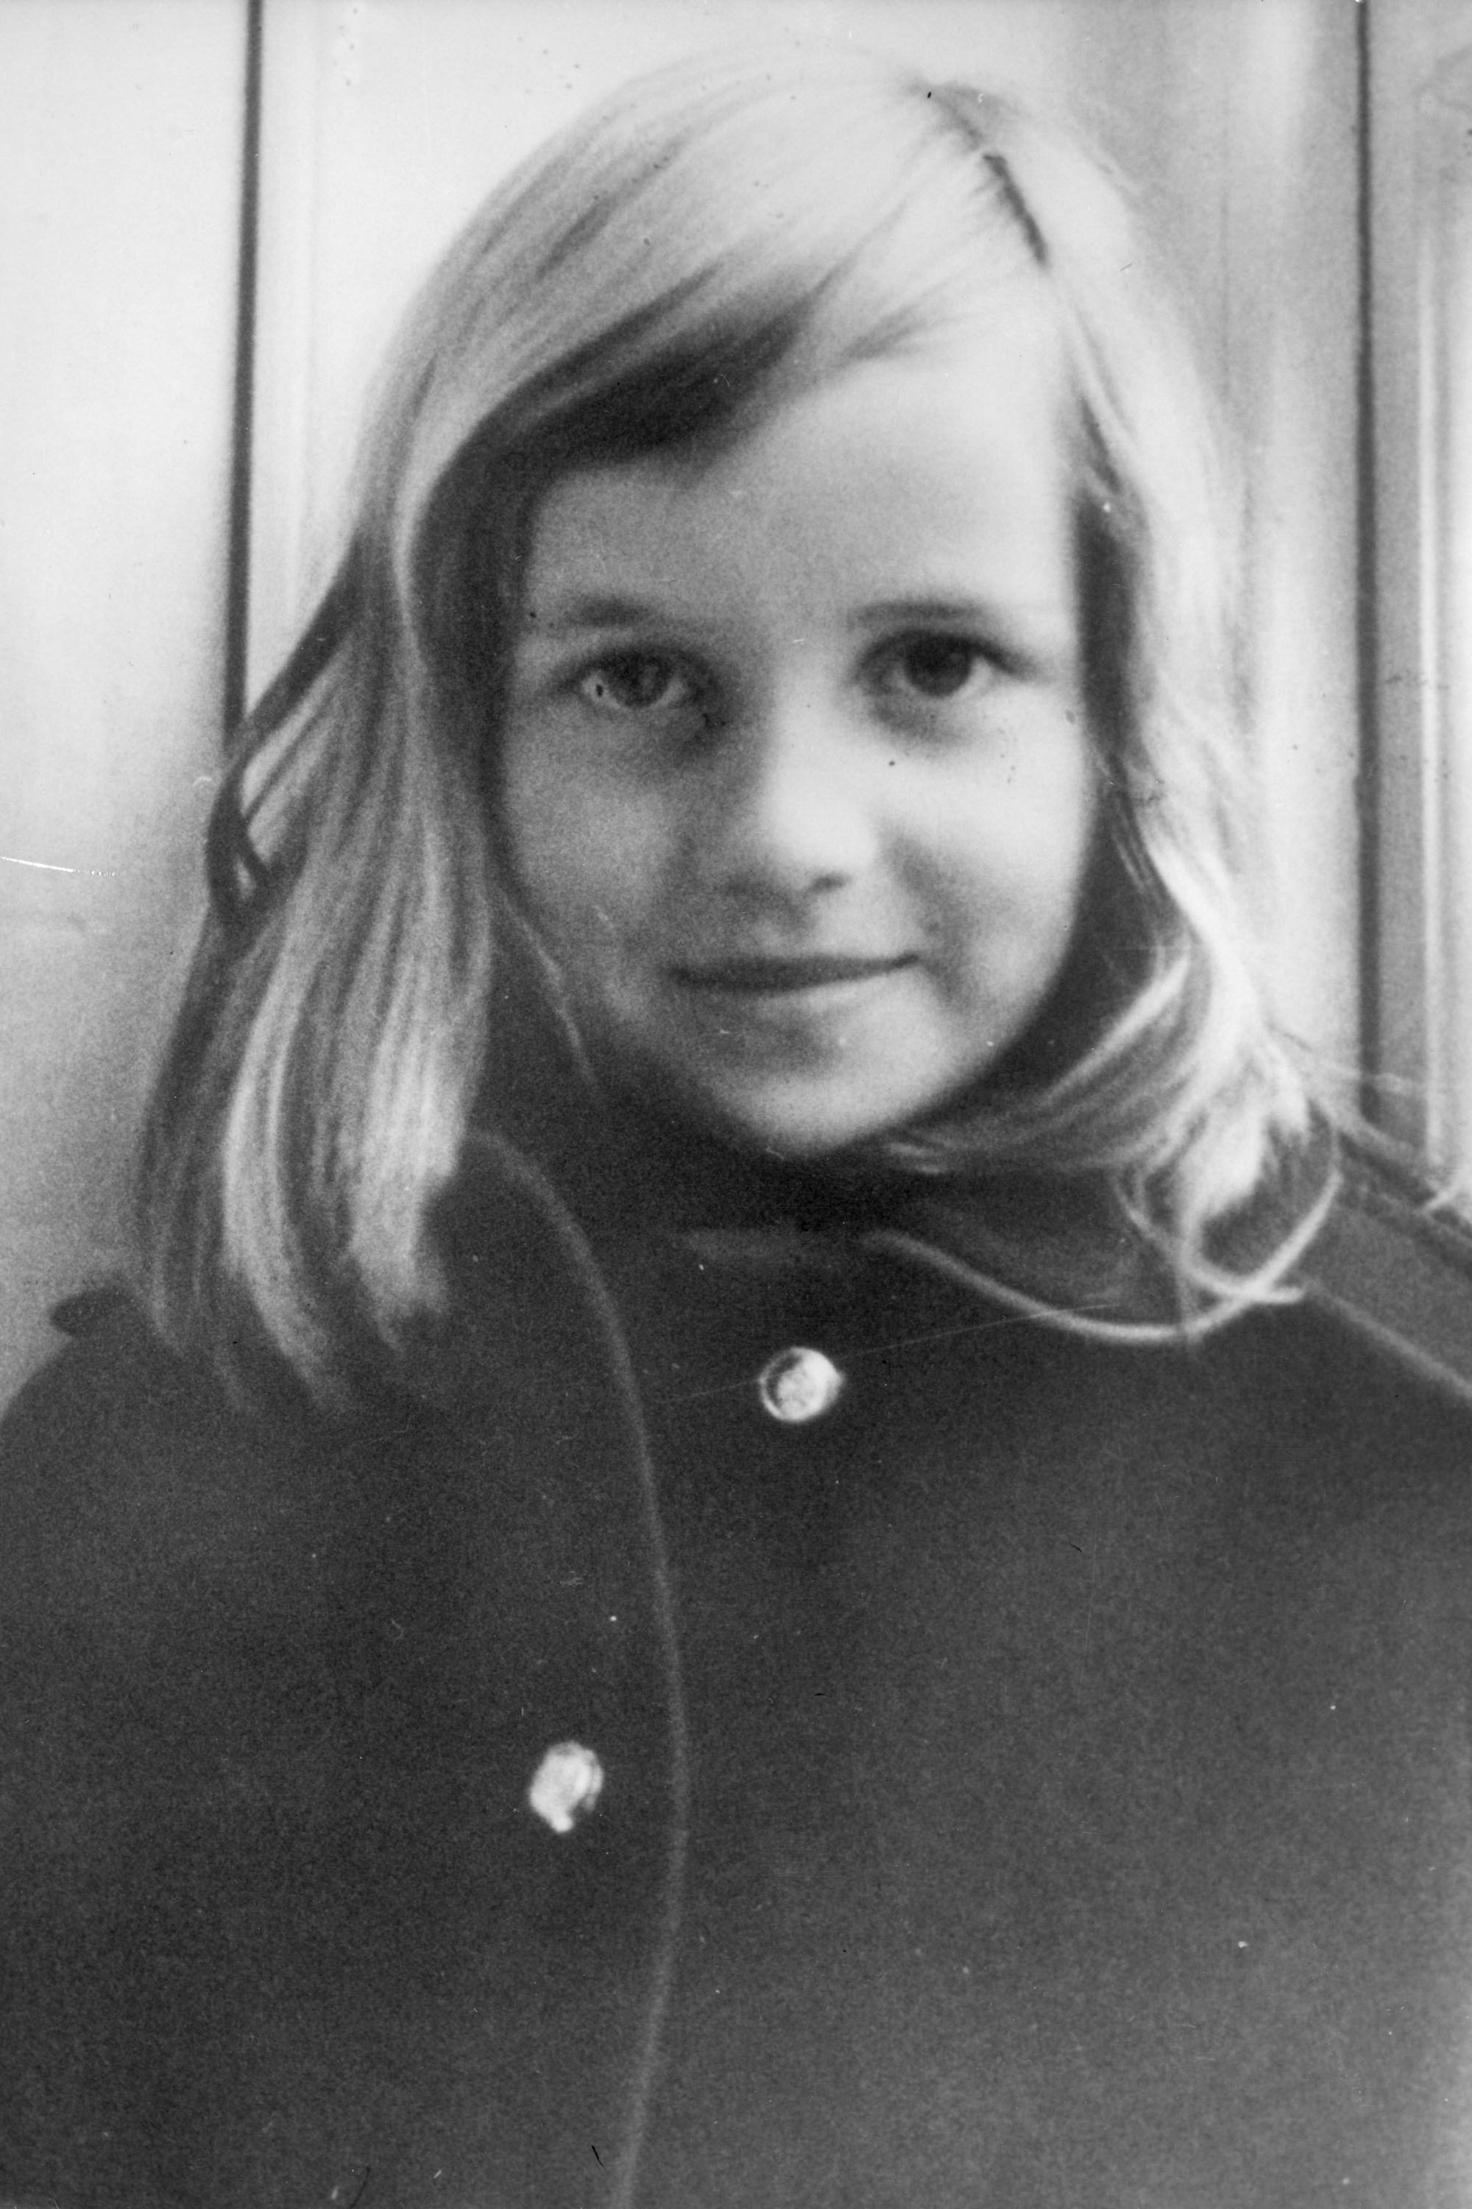
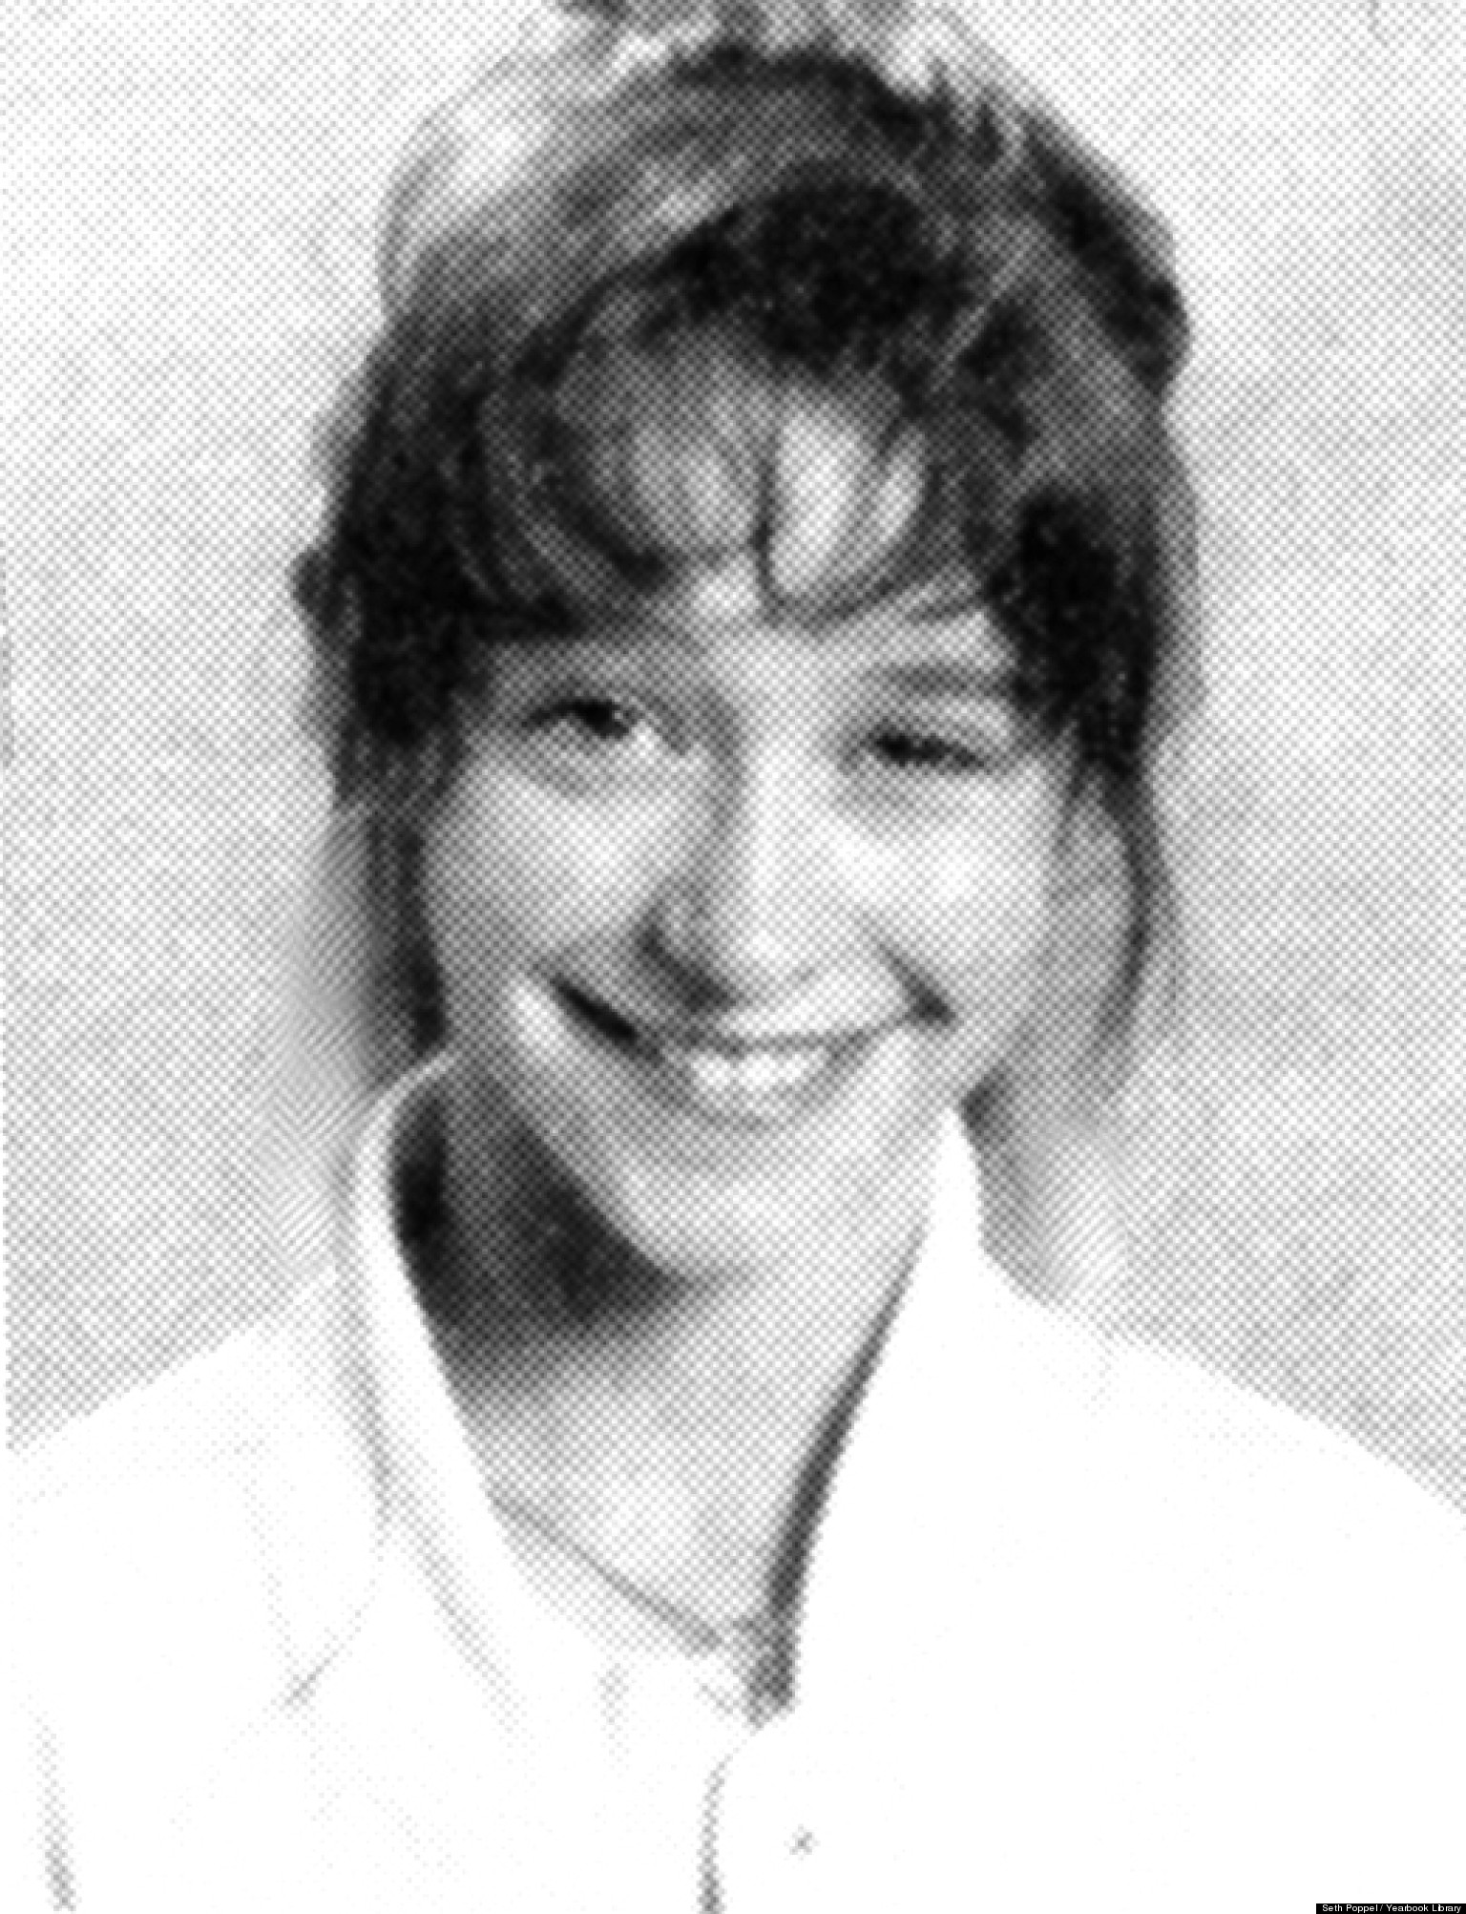
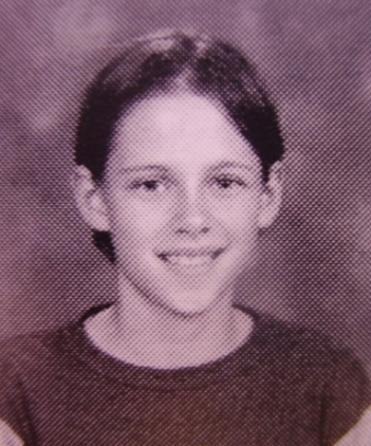
Guess the celeb…
1
4
3
2

Slide 15
ROUND 4:
sports

Slide 16
The questions:
Q1: Which sports quiz show has been presented by Sue Barker since 2007?
Q2: Which is the only men's tennis Grand Slam trophy that is gold?
Q3: Which fictional television show centered around Earls Park Football Club?
Q4: Whose wardrobe 'malfunction' during the 2004 Super Bowl caused a stir at halftime?
Q5: What are the 5 colours of rings on the Olympic flag?
Q6: What is the only Olympic sport where men and women compete equally in every event?
Q7: In snooker, how many points are awarded for potting the yellow ball?
Q8: Which member of the British royal family won the BBC Sports Personality of the Year Award in 2006?
Q9: Which Welsh football club used to play at Vetch Field?
Q10: Prior to becoming Muhammad Ali, what was Ali's birth name?
B

Slide 17
ROUND 5:
General knowledge

Slide 18
The questions:
Q1: Which novel by Margaret Mitchell won the Pulitzer prize for fiction in May 1937?
Q2: Aristotle Onassis founded which airline in 1957?
Q3: What year did Princess Diana (Queen of Hearts) Die?
Q4: What is the most consumed manufactured drink in the world?
Q5: ‘Floreat Etona’ is the motto of which British public school?
Q6: Which 'M' is Britain's leading hospital specialising in eye injuries?
Q7: In Fashion, who was the head of the House of Chanel from 1983 - 2019?
Q8: Gin is a distilled grain flavoured with which type of berry?
Q9: Based on their original names, Joseph Alois Ratzinger & Jorge Mario Bergoglio served which religious position?
Q10: Who was Princess Margaret's First Husband?
B

Slide 19
ROUND 6:
music

Slide 20
The questions:
Q1: American singer Stefani Joanne Angelina Germanotta is best known by which stagename?
Q2: The song 'C'est la Vie' saw which group become the youngest girl group to top the UK charts with their debut single?
Q3: SOLVE THIS BAND ANAGRAM: GRIPS SLICE
Q4: Who had the last UK number one of 2018 with her single ‘Sweet but Psycho’?
Q5: Roger, Pete, Keith and John make up what?
Q6: Which comedian wrote the music and lyrics to the musical “Matilda”?
Q7: Who recorded the theme music to the 2015 James Bond film ‘Spectre’?
Q8: Complete the Band, Huey Lewis and the…
Q9: Whose voice can be heard singing ‘Let It Go’ in Disney’s ‘Frozen’?
Q10: Lang Lang is famous for playing which musical instrument?
A

Slide 21
Lockdown 2020
Thank you!

